Slide 1


International Colloquium on Equatorial and Low Latitude Ionosphere
9th-13th September, 2019
University of Lagos
Variability of ionospheric irregularities over the longitudinal sectors of African equatorial/low latitude region during the St. Patrick’s Day storm of 17 March 2013
P. O. Amaechi¹, E. O. Oyeyemi², A. O. Akala²
¹ Chrisland University, Owode, Abeokuta,
² University of Lagos, Yaba, Lagos
(paoloobiaks@yahoo.fr)

Slide 2
OVERVIEW OF THE PRESENTATION
Background of the study
Data and Method of Analysis
Event analysis and discussion
Summary

Slide 3
Background of the study
The Ionosphere:
Ionized part of the Earth atmosphere.
Affects radio signal by virtue of its electrons.
    Quiet ionosphere
signal group delays and carrier advance
(variation in refractive index of the ionosphere).
    Turbulent ionosphere
Presence of irregularities.
Diffraction of signals occurs.
Severe effect imposed on the signals (scintillations).

Slide 4
Background
Scintillations
(Signal fluctuations)
Amplitude scintillation (S4)
Signal fading
Signal loss
Phase scintillation (ROTI)
Cycle slip
Fig.1a:Ionospheric effect on radio signals

Slide 5
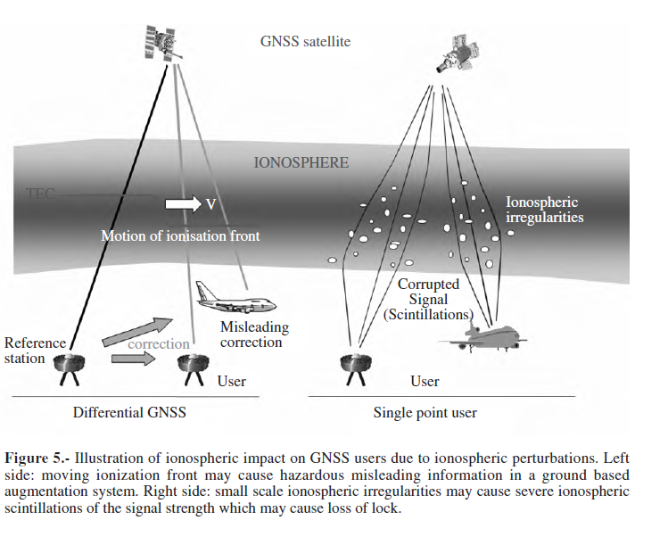
Background
Left:
Strong horizontal gradient in TEC may
Lead to GNSS error.
SBAS can give misleading corrections to an aircraft. This can be dangerous during landing.
Right:
Small ionospheric structures diffract GNSS signals causing them to fluctuate.
Loss of lock may occur.
Fig. 1b: Ionospheric effect on GNSS user (Jakowski et al., 2008).

Slide 6
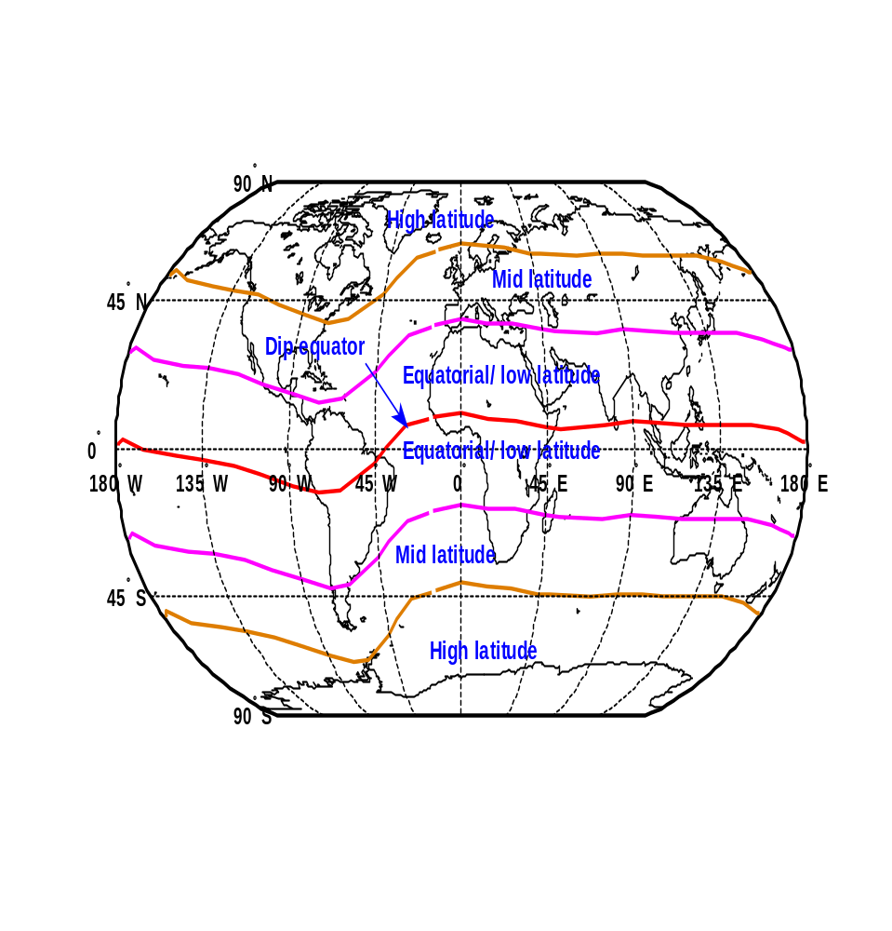
Background
The equatorial region
(magenta lines) is the region within ±15º dip.
Red line = magnetic equator (dip = o)
Ionospheric effects
on GPS signals are pronounced over the equatorial region.
Fig. 2: Latitudinal regions of the ionosphere

Slide 7
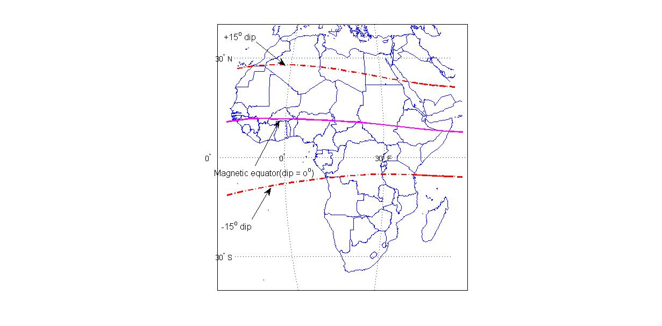
The African EIA Region: Variations
Noon
4.91° to 7.36° and −9.17° to −12.62°
Post-sunset period
8.00° to 11.7° and −9° to −16°
[Amaechi et al., 2018c].
Fig. 3: Variations of the African EIA region

Slide 8

Background
Ionospheric effects could be drastic and unpredicted during geomagnetic storms
Fig. 4: Shock wave resulting from a solar storm (www.express.co.uk)

Slide 9
Background
This work examines variations of irregularities during the geomagnetic storm of March 2013 (The double storm of March 2013).
Why this storm:
Similar features to the one of 2015 (Most intense). Hence opportunity for comparisons
Least studied over the African EIA region.
Larger data availability to shred more light on unresolved issues such:
  Spatial and temporal latitudinal behaviour.
  Longitudinal asymmetries.
  The contribution of PPEF, DDEF, PPEF+DDEF.

Slide 10
Data and method of analysis
Data
  SYM-H (monitor the disturbance).
  Vx (Monitor solar wind conditions).
  IMF Bz (changes in interplanetary conditions).
  Polar cap index - Quantitative estimate of Joule heating.
  H component of geomagnetic field.
  TEC- compute ROTI.
  Ionosonde -Ionogram.

Slide 11
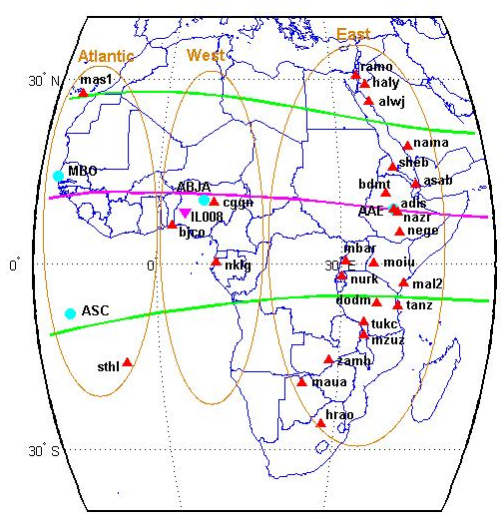
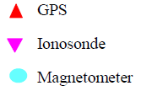
Fig.5: Geographic locations of the stations

Slide 12
METHOD OF ANALYSIS
Diono was computed as:
where ψ is the dip latitude and S_{R} is the daily quiet regular variation of H.
where DP2 is the disturbance polar no. 2 signal related to PPEF and Ddyn is the disturbance dynamo signal related to DDEF.
ROTI was calculated:
where ROT is the rate of change of TEC in TECU/min.
(1)
(2)
(3)

Slide 13
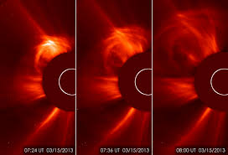
EVENT ANALYSIS AND DISCUSION
Solar origin of the disturbance: Fast CME,15/03/15
07:24 UT
07:36 UT
08:00 UT
Fig.6: Coronagraph obtained from the Solar Heliospheric Observatory (SOHO) satellite on March 15. [https://www.nasa.govv/mission_pages]

Slide 14
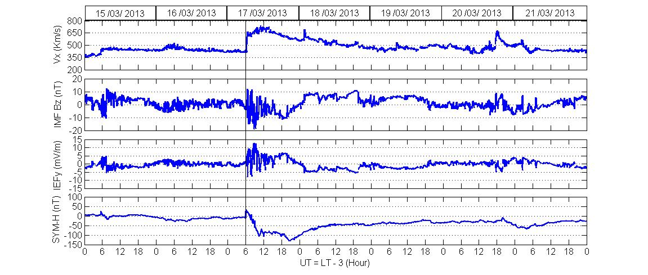
Interplanetary and magnetic conditions
Fig. 7: Variations of interplanetary parameters: Vx, IMF Bz, IEFy, and SYM-H from 15-21 March 2013

Slide 15
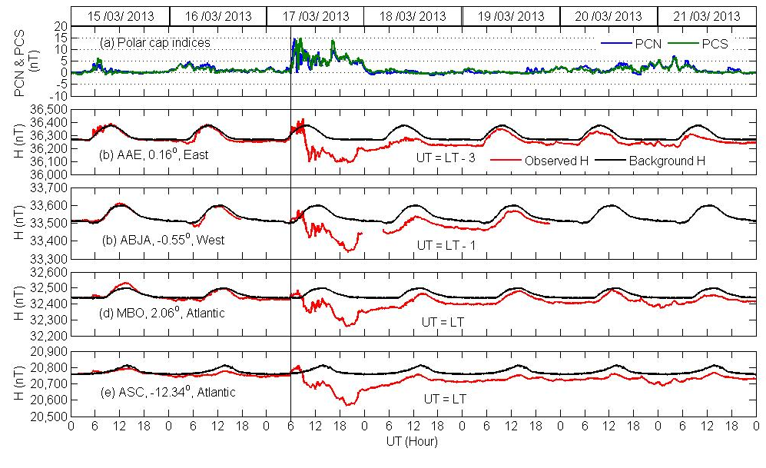
Polar cap condition and geomagnetic field response at equatorial region
Fig. 8: Variations of Polar cap and H over AAE, ABJA, MBO and ASC from 15-21 March 2013

Slide 16
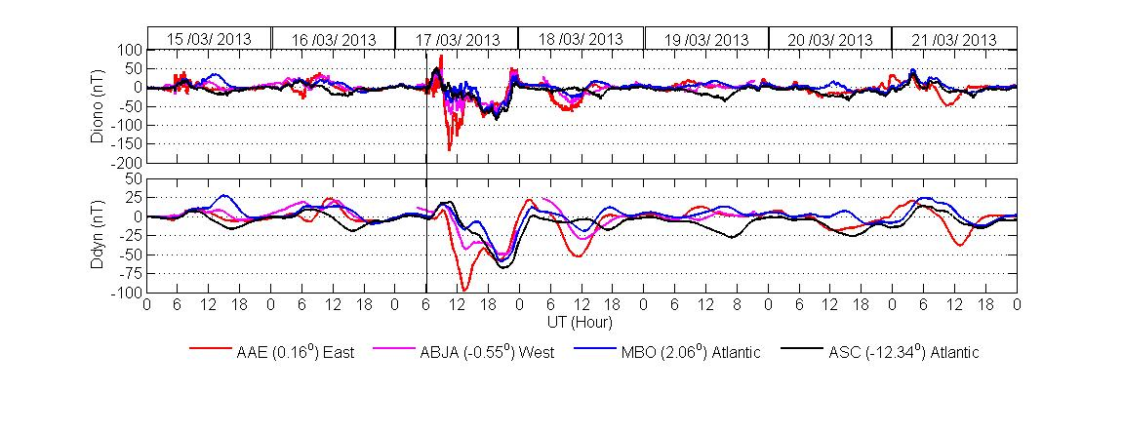
Ionospheric disturbed electric field at low-latitude
Fig. 9: Variations of Diono and Ddyn over Addis Ababa (AAE), Abuja (ABJA), Mbour (MBO) and Ascension (ASC) from 15-21 March 2013

Slide 17
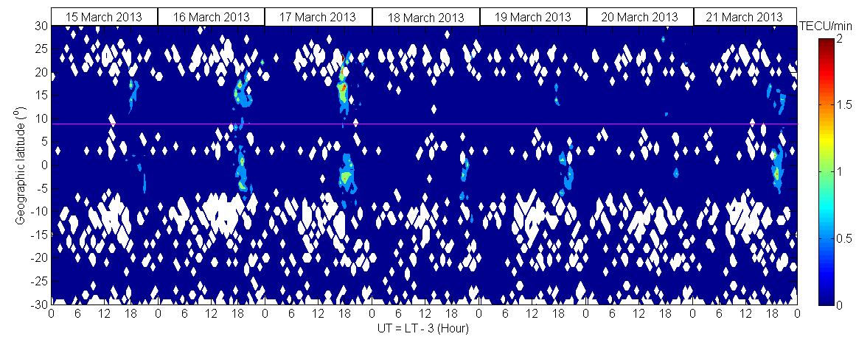
LATITUDINAL VARIATIONS OF IRREGULARITIES OVER EASTERN SECTOR
Fig. 10: Latitudinal variations of ionospheric irregularities over mean longitude 37º from 15-21 March 2013

Slide 18
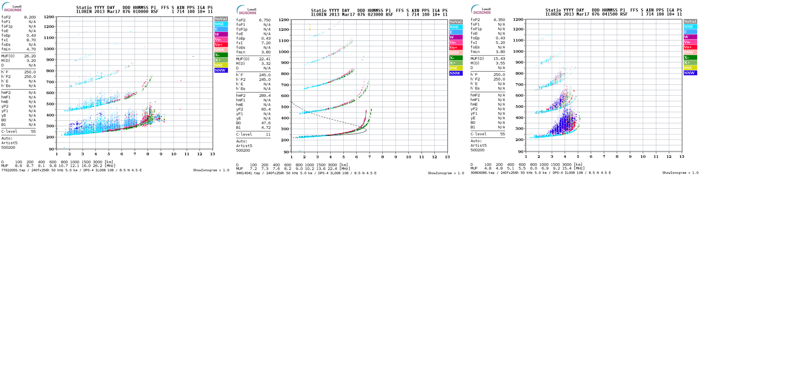
01:00 UT, h’F2=250 km
02:30 UT h’F2=245 km
04:15 UT h’F2=250 km
Fig. 11: Ionogram at Ilorin on 17 March 2013

Slide 19
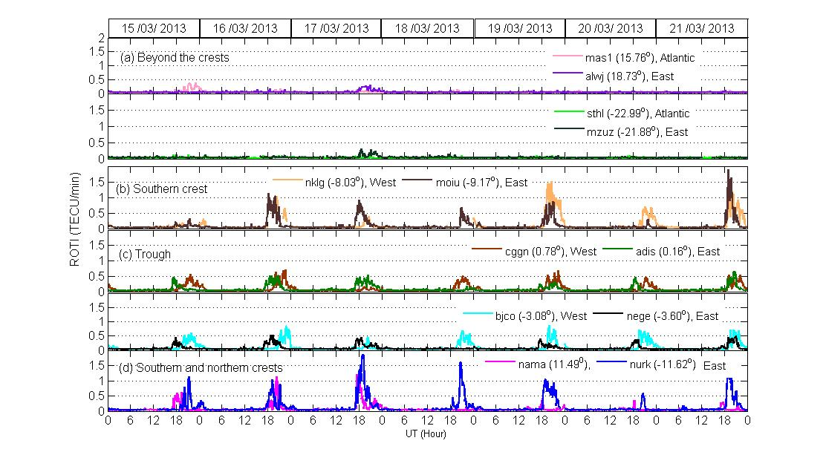
Fig. 12: (a-c) Longitudinal variability and (d) asymmetry of ionospheric irregularities from 15-21 March 2013

Slide 20
SUMMARY
Complex variability of irregularities over the African EIA.
An eastward PPEF enhanced the ExB drift hence, the strength and latitudinal extent of irregularities over both crests on 17 March.
Asymmetry in irregularities over the crests in both hemisphere of the EIA.
Longitudinal differences (longitudinal asymmetry) in irregularities behaviour over Africa .
The findings highlight the need to investigate further mechanisms responsible for irregularities generation using addition tools.

Slide 21
Thank you for your attention

